Slide 1

Chapter 31
Browser Identification

Slide 2
Learning Objectives
What a “hack” is and why Web developers try to avoid them
How to determine a browser’s user-agent setting using JavaScript
How to determine a user’s browser type
What ways exist to identify a mobile browser
How to determine an Internet Protocol (IP) address

Slide 3
A Word on “Hacks”
If you speak with Web developers, you will encounter a variety of opinions with respect to whether or not one should perform browser-specific processing within the pages they create.
Many developers will refer to such processing as a “hack,” because it can lead to code which is difficult to understand and hard to maintain.
Other developers, in contrast, will criticize the common browsers for not yet providing across-the-board standards.
In either case, before you perform browser-specific processing, ask yourself if there is another approach that may produce code that will work now and in the future.

Slide 4
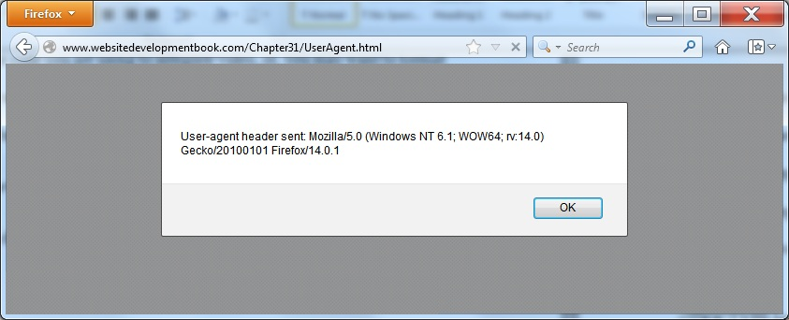
Understanding the User Agent
A user agent is a program that performs one or more tasks for the user. When a user surfs the Web, the browser is the user agent. One of the ways to determine a user’s browser type is to ask the browser to specify its user-agent value. The following HTML file, UserAgent.html, uses JavaScript to request the user-agent value and then uses an alert dialog box to display the corresponding value:
<!DOCTYPE html> <html> <body> <script type="text/javascript"> alert("User-agent header sent: " + navigator.userAgent); </script> </body> </html>

Slide 5
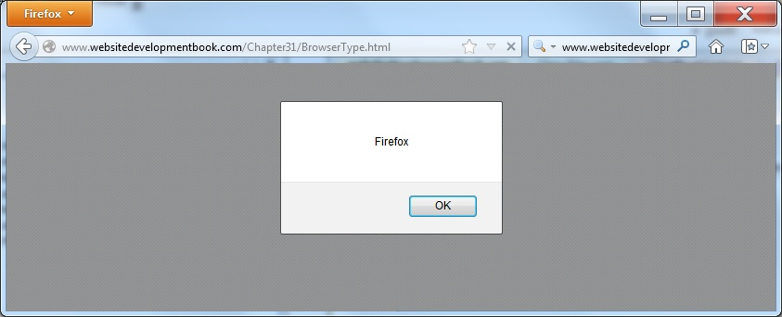
Browser type
By parsing the user-agent value, your code can determine the specific browser type. The following HTML file, BrowserType.html, uses a series of if-else statements to display the current browser type:
<!DOCTYPE html> <html> <body> <script type="text/javascript"> if (navigator.userAgent.indexOf("Safari") !=-1) alert("Safari"); else if (navigator.userAgent.indexOf("Chrome") !=-1) alert("Chrome"); else if (navigator.userAgent.indexOf("Opera") !=-1) alert("Opera"); else if (navigator.userAgent.indexOf("MSIE") !=-1) alert("Internet Explorer"); else if (navigator.userAgent.indexOf("Firefox") !=-1) alert("Firefox"); else alert("Other browser"); </script> </body> </html>

Slide 6
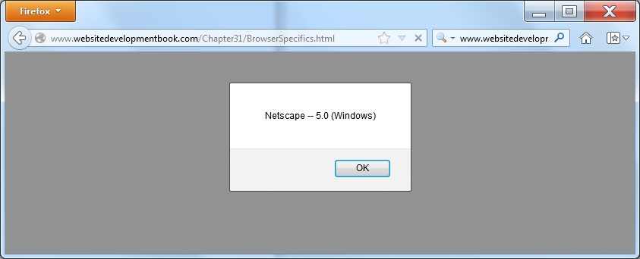
Browser specifics
In a similar way, the following HTML file, BrowserSpecifics.html, uses the navigator object appName and appVersion fields to display the browser name and version:
<!DOCTYPE html> <html> <body> <script type="text/javascript"> alert(navigator.appName + " -- " + navigator.appVersion); </script> </body> </html>

Slide 7
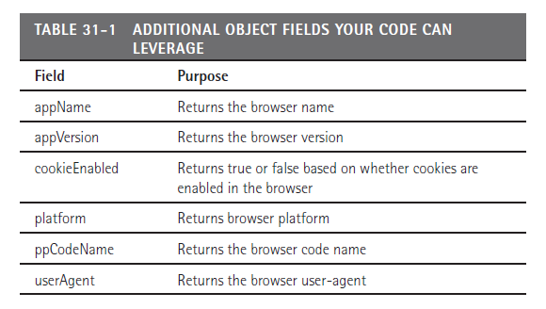
Other Navigator Objection Fields

Slide 8
Identifying a Mobile Browser
Many developers use the same page content for Web-based and mobile browsers. As you know, mobile devices have a much smaller screen display than their PC-based counterparts. As such, a developer may need to display smaller, more compact, or less content for a mobile browser.
One way to detect a mobile browser is to use a technique similar to those just shown to determine and parse the user-agent setting. Unfortunately, there are many different mobile agents, which makes such processing hard to understand and difficult to maintain. Worse yet, the number of agents change.
As an alternative, some developers use the JavaScript screen object to determine the browser’s screen settings (height and width). The following HTML file, BrowserScreenResolution.html, displays an alert dialog box that contains the browser screen width and height:
alert ("Browser resolution: " + screen.width + " x " + screen.height);

Slide 9
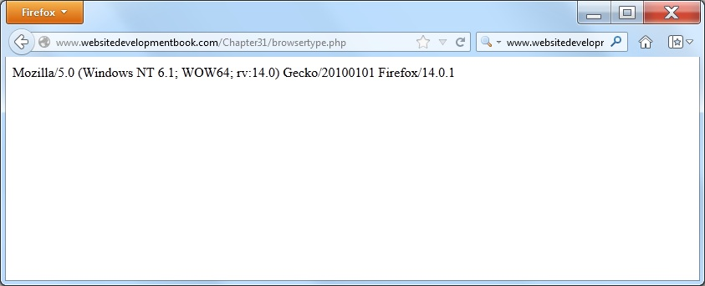
Determining the Browser Type on the Web Server
The previous examples used JavaScript on the client (user) side to determine browser specifics. If you are writing server-side applications, you can use a scripting language, such as PHP, to determine the browser type and then download appropriate content dynamically.
The following PHP script, BrowserType.php, which you can access at http://www.WebSiteDevelopmentBook.com/Chapter31/BrowserType.php, uses server-side processing to display browser specifics:
<?php print $_SERVER['HTTP_USER_AGENT']; ?>

Slide 10
Let Others Do the Mobile Device Detection Work
As you might guess, the ability to detect a mobile browser has become very important to many companies. Across the Web, several companies, such as http://DetectMobileBrowsers.com, provide code snippets you can use to accurately detect a mobile browser. The advantage of using such a site’s code is that most such sites do a good job of keeping the browser list current.

Slide 11
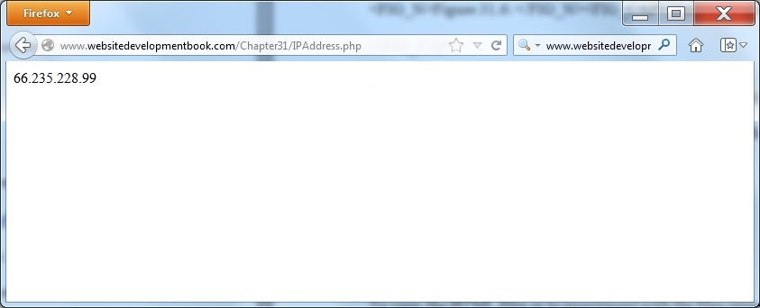
Real World Web Development Determining an Internet Protocol Address
Depending on the processing your webpages perform, sometimes you will need to know the user’s Internet Protocol or IP address. You might need such information for advertisement processing and billing, or you may have sites that you want to prevent from accessing your content (a blacklist). Often, you will perform such IP-address processing on the server side. The following PHP script, which you can access at http://www.WebSiteDevelopmentBook.com/Chapter31/IPAddress.php, displays the user’s IP address, as shown:
<?php print $_SERVER['REMOTE_ADDR']; ?>

Slide 12
summary
Depending on the processing your webpages perform, there may be times when you need to know specifics about a user’s browser.
You might use such information, for example, to customize the display for a mobile device or control how your page integrates audio or video. In this chapter, you learned how to determine a user’s browser type using JavaScript as well as server-side scripts.
Before you perform such processing on your own pages, however, keep in mind that such code can be difficult to understand and hard to maintain.

